Slide 1
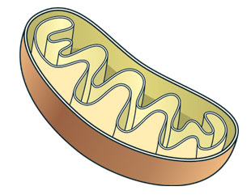
Metabolic Diseases Lesson 2.2
Metabolism –
How do your cells release energy from food?

Slide 2
Do Now
Label the parts of the mitochondrion on the worksheet.

Slide 3
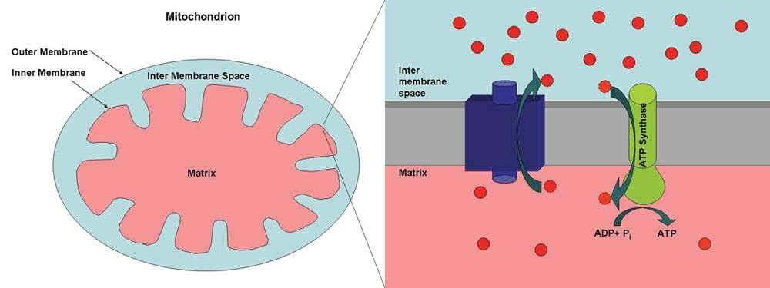
Do Now
Notes:
Discuss the parts in the image on the right.

Slide 4
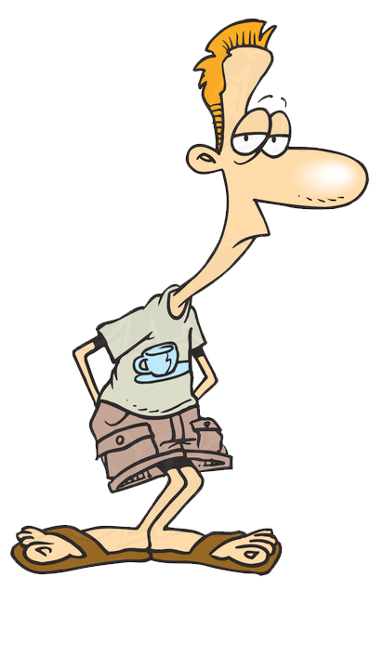
Activity: Part 1: Dougie’s Problem
Read Part 1 of the case study and answer the questions in your groups:
What is the problem Dougie is facing and how is he considering fixing it?
How does the mitochondria transfer energy from sugars and fats to ATP?

Slide 5
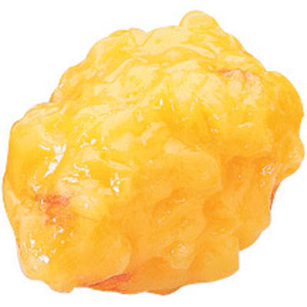
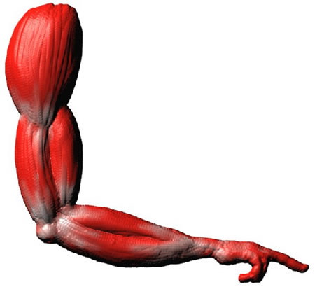
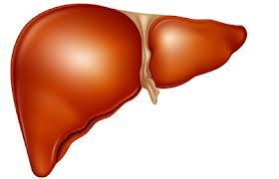
Cells get their energy from ATP but it is delivered as macronutrients
Glucose
Amino Acids
Fatty Acids
Citric Acid Cycle
NADH & FADH₂
ATP synthesis via the electron transport chain

Slide 6
Glucose
Gluconeogenesis
Glycolysis
Amino Acids
Fatty Acids
Deamination
Lipolysis
Gluconeogenesis = making new glucose from amino acids
Glycolysis = breaking down glucose
Lipolysis = breaking down lipids
Deamination = removing the amine group from amino acids so that only carbons remain
Citric Acid Cycle
Carbons from sugars and fats are shuttled through Citric Acid Cycle, where the energy from is used to put H⁺ onto NADH and FADH₂
NADH & FADH₂
ATP synthesis via the electron transport chain

Slide 7
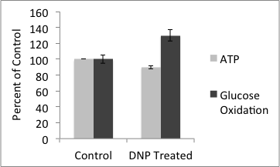
Case Study Part 2: What does the mitochondria have to do with DNP?
Read Part 2 of the case study and answer the questions in your groups

Slide 8
Case Study Part 2: What does the mitochondria have to do with DNP?
What happens to ATP and glucose oxidation (glycolysis) levels in response to treatment with DNP?
What does the proton gradient look like when DNP uncouples ATP synthesis?

Slide 9
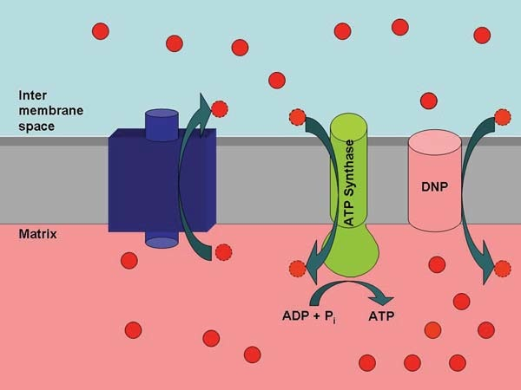
Case Study Part 3: What should Dougie do?
Read Part 3 of the case study and answer the questions in your groups. ETC ATP Synthase

Slide 10
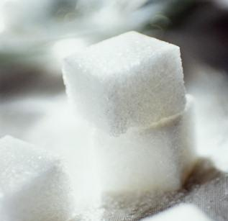
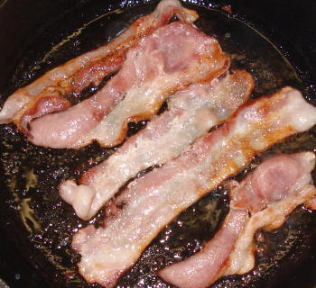
Inter
membrane
space
Matrix
ADP+P_{i}
ATP
Notes:
Suggest the number of protons moving through the channel as well as the ATPase is more than one.

Slide 11
Inter
membrane
space
Matrix
ADP+P_{i}
ATP

Slide 12
Inter
membrane
space
DNP
ATP Synthase
Matrix
DNP protein allows for the flow of protons from the High concentration to the Low concentration until both sides are equal.
No gradient means there will no longer be energy released from the protons traveling down the ATP synthase

Slide 13
Case Study Part 3: What should Dougie do?
Should Dougie use DNP to lose weight?

Slide 14
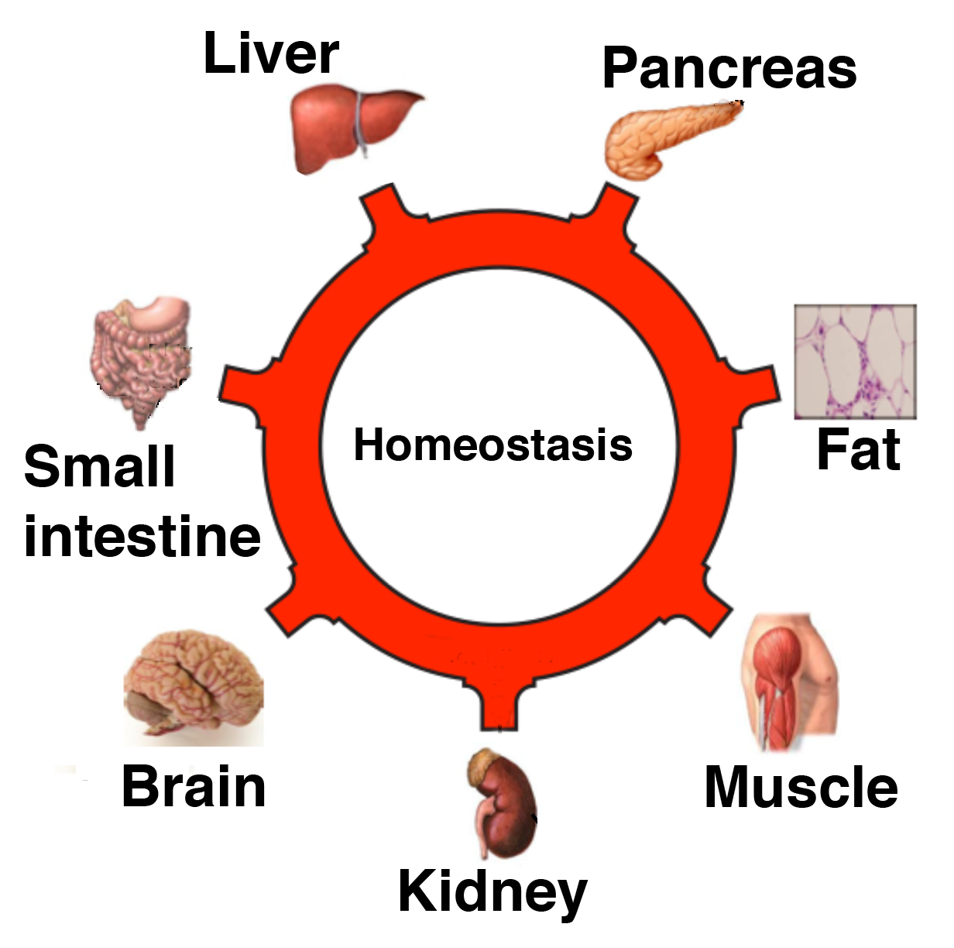
Wrap Up
ATP cannot be transferred from cell to cell but GLUCOSE can!

Slide 15
Wrap Up
All cells can use glucose to make ATP, but not all cells can use fatty acids or amino acids.
The blood and brain must have a constant supply of glucose for the cells to use for energy.

Slide 16
Homework
Complete the homework questions on the Case Study Worksheet.

